Slide 1




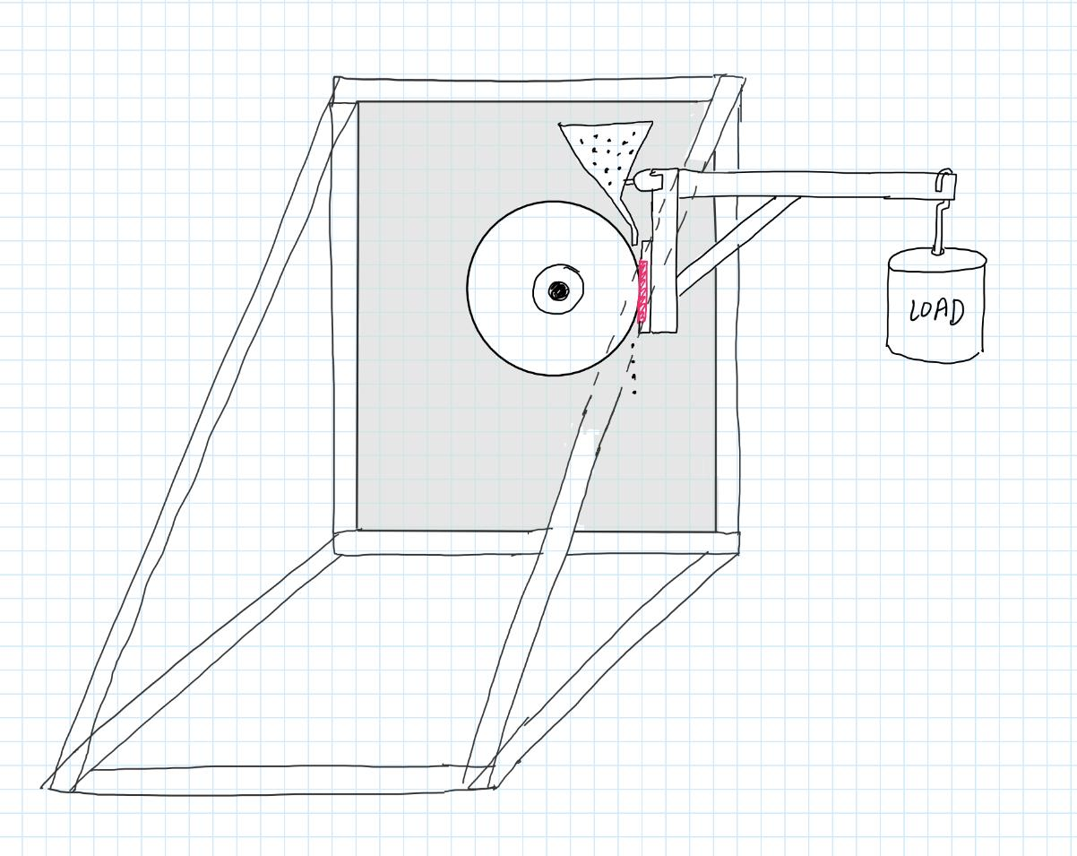
VERIFICATION
Abrasion Rig Plans
4/9/21
Parul Singh
Budget/Timeline for Abrasion Rig (assuming we have to build our own):
Abrasion Rig Parts Needed and approximate cost:
Motor, large wheel with rubber rim, T-slot rails for metal frame, loading weights, abrasive dust simulant, funnel
Abrasion Rig Design:
(Doesn’t need to be triangles
on the left and right, can be a cube
shape, just needs a supportive frame)
Weekend Plans:
Calculate exact dimensions, do calculations to find the speed of the wheel and choose a motor accordingly, choose parts

